Slide 1





Understanding Personalized Learning Data Analysis
Welcome! This presentation offers a step-by-step guide to data processing and uncovering AI insights for personalized learning. We'll explore how to gather, clean, visualize, and analyze student data to create effective learning experiences. Let's dive in and transform raw data into actionable intelligence. Get ready to empower education with the magic of data science!
KH
Mr. Raviraj Nawle
Mr. Krishna Hiwale
Ms. Kasturi Bhuvad

Slide 2


Preparing Our Tools
1
Numpy
Your go-to library for numerical operations and array manipulation. Essential for data analysis and calculations.
2
Pandas
Provides data structures like DataFrames for easy data organization, cleaning, and manipulation. Think of it as a powerful spreadsheet organizer.
3
Matplotlib & Seaborn
Powerful visualization tools for creating charts, plots, and graphs. Use them to see underlying data patterns. Matplotlib is the foundation, and Seaborn is used for adding fancy styles.
4
OS
Allows you to interact with the operating system, such as navigating directories and managing files. Think of it as a file folder organizer.

Slide 3


Finding Our Notebook & Opening Student Files
Code Snippet
Explanation
First, we use os.chdir() to navigate the computer to the directory containing the data. Then, we use pd.read_csv() and pd.read_excel() to read the data. The read_csv() function imports data from comma-separated values files. The read_excel() function imports data from excel files.
os.chdir("C:/Users/rjnaw/Downloads") learning_1 = pd.read_csv("Personalized Learning.csv") learning_2 = pd.read_excel("Personalized Learning.xlsx")

Slide 4








Making a Safe Copy & Checking for Missing Info
Code Snippet
Explanation
Use the .copy() method to create a duplicate DataFrame for safe manipulation, ensuring the original data remains unchanged. .isnull().sum() identifies and quantifies missing values in each column, guiding subsequent data cleaning strategies.
Personalized = learning_1.copy() Personalized.isnull().sum()

Slide 5





Removing Useless Columns & Fixing Missing Data
Fill Numerical
Replace missing numerical values using the median. This maintains data integrity by using a measure of central tendency.
2
Drop Unnamed
Remove columns with names like "Unnamed" as they often contain no useful information and clutter the dataset.
1
Fill Categorical
Impute missing categorical values using the mode. This ensures that categorical data remains complete and representative.
3

Slide 6



Converting Words to Numbers
Label Encoding
Encoding Gender
Label Encoding transforms categorical data into numerical format, essential for machine learning algorithms. It assigns a unique integer to each category.
To convert the "Gender" column, initiate LabelEncoder. Next, apply the fit_transform method to convert gender categories (e.g., male, female) into numerical labels (e.g., 0, 1).

Slide 7



Creating Visual Stories
Test Score Distribution
Subject Popularity
sns.histplot(Personalized["Test_Score"])
sns.countplot(y="Course")
Use sns.histplot to visualize the distribution of test scores. Histograms provide insights into the frequency and range of scores, revealing patterns in student performance.
Apply sns.countplot to illustrate course popularity. Bar charts display the count of students enrolled in each subject, highlighting trends in course selection.

Slide 8




Building Smart Predictors
1
Regression
rf_regressor = RandomForestRegressor() rf_regressor.fit(X_train, y_train)
The RandomForestRegressor predicts continuous values (e.g., test scores) based on features like study hours. The fit method trains the model on the training data, learning relationships between features and scores.
2
Classification
rf_classifier = RandomForestClassifier()
The RandomForestClassifier predicts categorical outcomes (e.g., course selection) based on student characteristics. The fit method trains the model on the training data, learning associations between features and subjects.

Slide 9

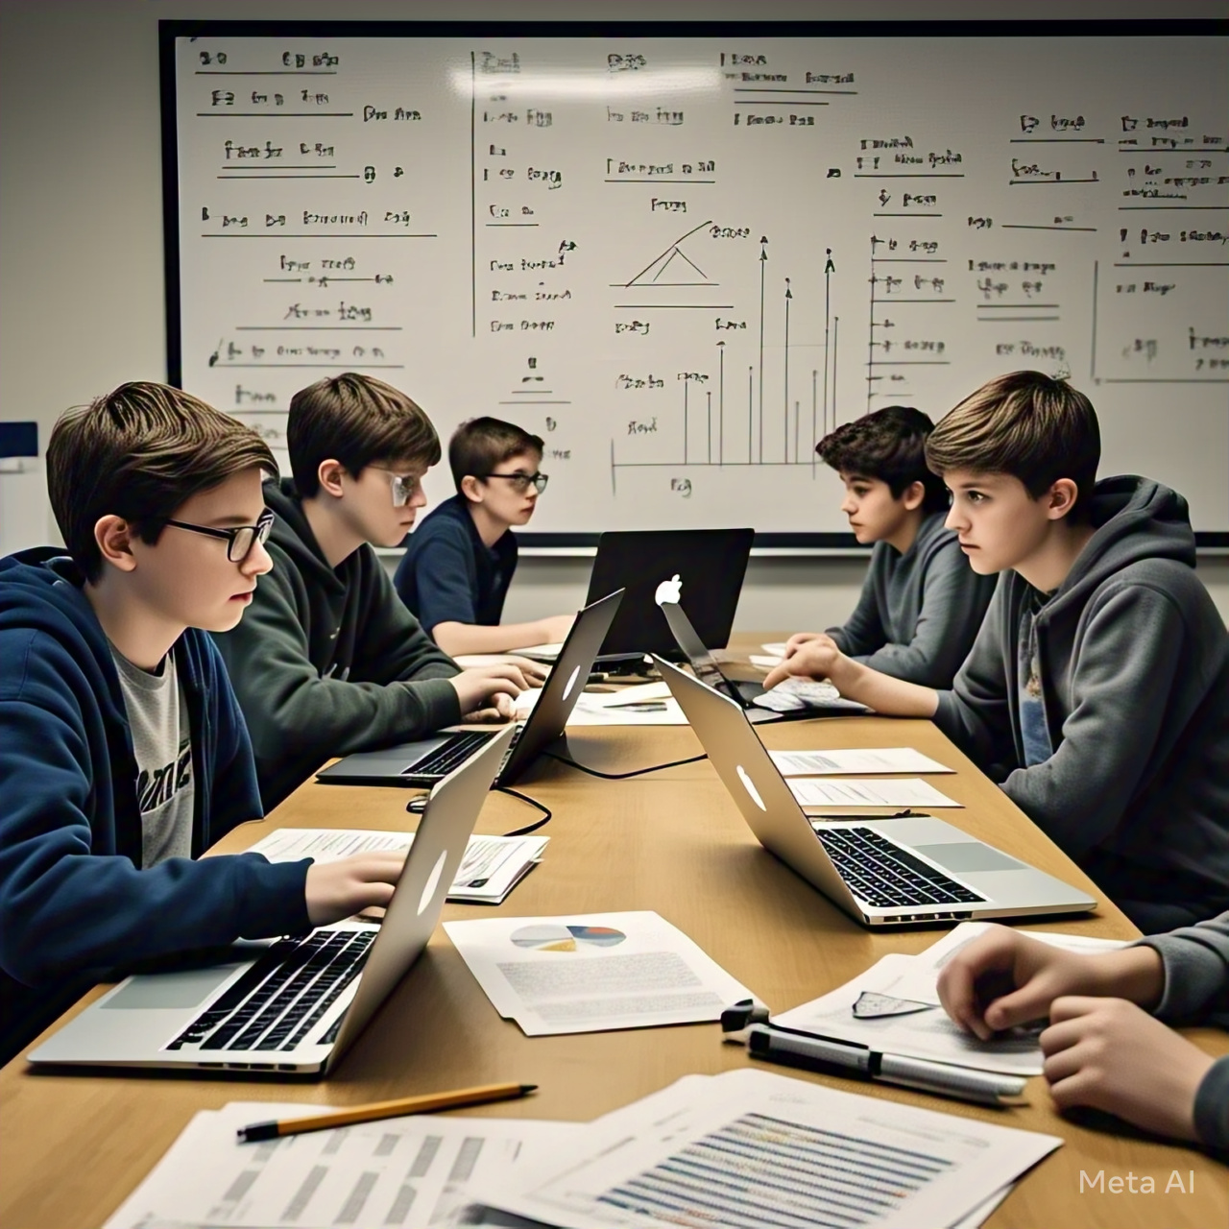


Understanding Key Factors & Student Grouping
Feature Importance
feature_importances.plot()
Plot feature importances to reveal which study habits most influence test scores. This visualization aids in understanding key factors driving student performance.
Student Clustering
kmeans = KMeans(n_clusters=3)
Use the K-means algorithm to cluster students into distinct groups based on their study habits. Set the number of clusters to 3 to create three distinct groups.

Slide 10



Conclusion
In summary, personalized learning powered by data science and machine learning offers a transformative way to improve education.
By understanding student behaviours, predicting learning paths, and adapting content, we can create more effective and engaging learning experiences. This project highlights the power of AI in shaping the future of education.

Slide 11



Questions & Discussion
This marks the end of our exploration into personalized learning data analysis! We encourage you to engage with the material and each other. Feel free to ask any questions you may have, share insights, or suggest alternative approaches. Together, let's unlock the full potential of data-driven learning!

Slide 12
Thank you for your time!
I’d love to answer any questions you may have

Slide 13
References
DeepSeek. (n.d.). Retrieved from https://deepseek.com
Perplexity AI. (n.d.). Retrieved from https://www.perplexity.ai
Google. (n.d.). Retrieved from https://www.google.com
OpenAI. (2024). ChatGPT. Retrieved from https://openai.com/chatgpt
Blackbox AI. (n.d.). Retrieved from https://www.blackbox.ai
Quadratic. (n.d.). Retrieved from https://www.quadratic.com
Kaggle. (n.d.). Retrieved from https://www.kaggle.com
Gamma. (n.d.). Retrieved from https://gamma.app
Art. (n.d.). Retrieved from https://www.imagine.art
Meta AI. (n.d.). Retrieved from https://ai.meta.com

